Slide 1
Module -3 IMAGE SEGMENTATION

Slide 2
References
Gonzales and Woods, “Digital Image Processing”, Pearson Education, India, Third Edition
Chapter -10- Image Segmentation
Digital image processing – Ramesh Jayraman
Digital Image processing – Sreedhar
Marks in Exam :- 18-20 Marks
Numerical - (books 1,2,3)
Chain code - 8M
Split and Merge algorithm – 6-8M

Slide 3
Chapter 10
Image Segmentation
Image segmentation divides an image into regions that are connected and have some similarity within the region and some difference between adjacent regions.
The goal is usually to find individual objects in an image.
For the most part there are fundamentally two kinds of approaches to segmentation: discontinuity and similarity.
Similarity may be due to pixel intensity, color or texture.
Differences are sudden changes (discontinuities) in any of these, but especially sudden changes in intensity along a boundary line, which is called an edge.

Slide 4
Chapter 10
Image Segmentation
(a) Image containing a region of constant intensity. (b) Image showing the boundary of the inner region, obtained from intensity discontinuities. (c) Result of segmenting the image into two regions. (d) Image containing a textured region.(e) Result of edge computations. Note the large number of small edges that are connected to the original boundary, making it difficult to find a unique boundary using only edge information. (f) Result of segmentation based on region properties.

Slide 5
Detection of Discontinuities
There are three kinds of discontinuities of intensity: points, lines and edges.
The most common way to look for discontinuities is to scan a small mask over the image. The mask determines which kind of discontinuity to look for.
W1 | W2 | W3
W4 | W5 | W6
W7 | W8 | W9
Generalized 3x3 mask

Slide 6
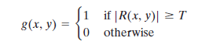
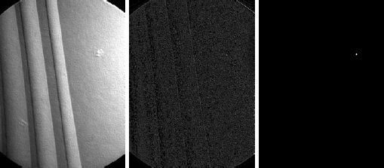
Detection of Isolated Points
It is done by 2nd derivative i.e. Laplacian mask
1 | 1 | 1
1 | -8 | 1
1 | 1 | 1

Slide 7
Find the location of the points as follows:
w=[-1 -1 -1; -1 8 -1; -1 -1 -1];
g=abs(imfilter ( double(f), w);
T=max(g(:));
g=g >=T;
imshow(g);

Slide 8
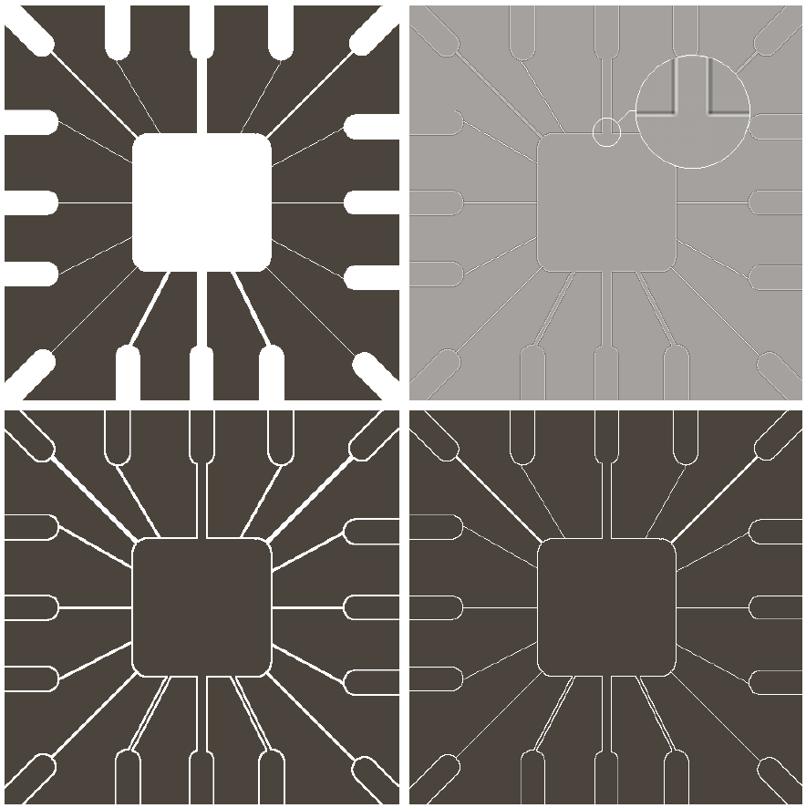
Laplacian for Line detection
(a) Original image.
(b) Laplacian
image; the
magnified section
shows the
positive/negative
double-line effect
characteristic of the
Laplacian.
(c) Absolute value
of the Laplacian.
(d) Positive values
of the Laplacian

Slide 9
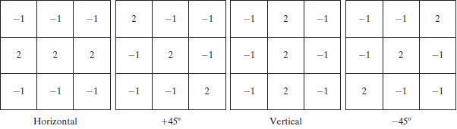
Detection of Discontinuities
Line Detection
Only slightly more common than point detection is to find a one pixel wide line in an image.
For digital images the only three point straight lines are only horizontal, vertical, or diagonal (+ or –45°).

Slide 10
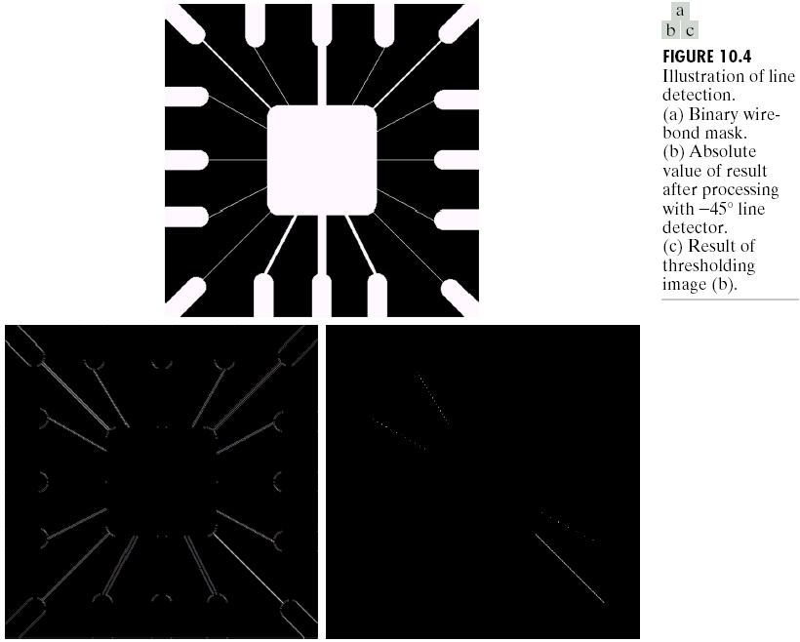
Detection of Discontinuities
Line Detection

Slide 11
Program
w=[2 -1 -1;-1 2 -1; -1 -1 2];
g=imfilter(double(f), w);
imshow(g, []) %Fig.10.4-b
g=abs(g(:));
figure, imshow(g, [ ]) % Fig.10-4-e
T=max(g (: ));
G=g >= T;
figure, imshow(g, [ ]) % Fig.10-4-f

Slide 12
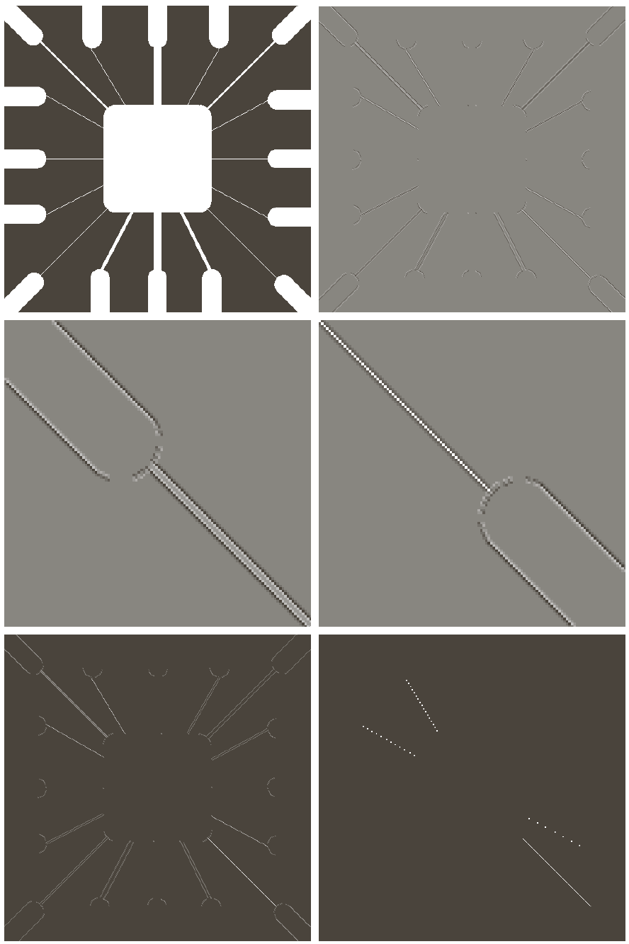
Detection of Discontinuities
Line Detection
(a) Image of a
wire-bond
template.
(b) Result of
processing with
the line
detector mask in
Fig. 10.6.
(c) Zoomed view
of the top left
region of (b).
(d) Zoomed view
of the bottom
right region of
(b). (e) The image
in (b) with all
negative values
set to zero. (f) All
points (in white)
whose values
satisfied the
condition
where g is the
image in (e).

Slide 13
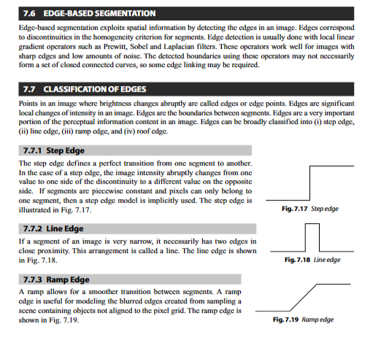

Slide 14
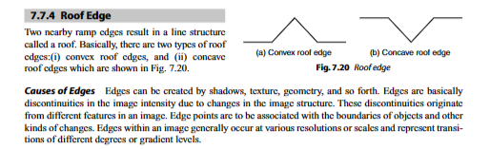

Slide 15

Detection of Discontinuities
Edge Models
From left to right, models (ideal representations) of a step, a ramp, and a roof edge, and their corresponding intensity profiles

Slide 16
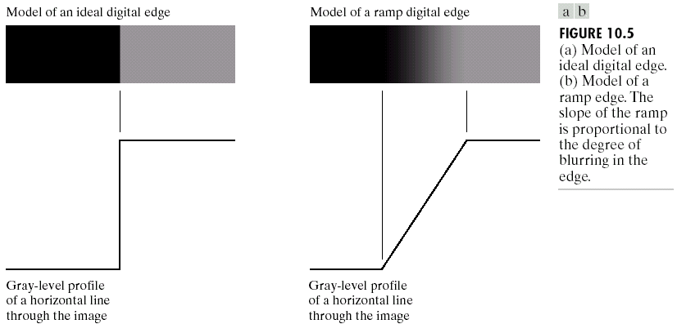
Detection of Discontinuities
Edge Detection

Slide 17
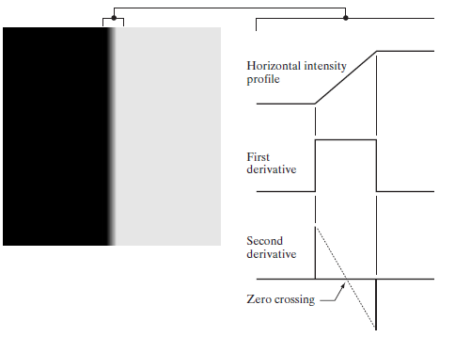
Detection of Discontinuities
Edge Detection
(a) Two regions of
constant intensity
separated by an
ideal vertical
ramp edge.
(b) Detail near
the edge, showing
a horizontal
intensity profile,
together with its
first and second
derivatives

Slide 18
Steps in edge detection
Image smoothing for noise reduction.
Detection of edge points. this is a local operation that extracts from an image all points that are potential candidates to become edge points.
Edge localization. The objective of this step is to select from the candidate edge points only the points that are true members of the set of points comprising an edge.

Slide 19
First column: Images and intensity profiles of a ramp edge corrupted by random Gaussian noise of zero mean and standard deviations of 0.0, 0.1, 1.0, and 10.0
intensity levels, respectively.
Second column: First-derivative images and intensity profiles.
Third column: Second-derivative images and intensity profiles.

Slide 20
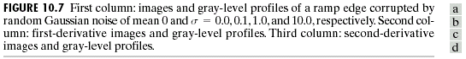
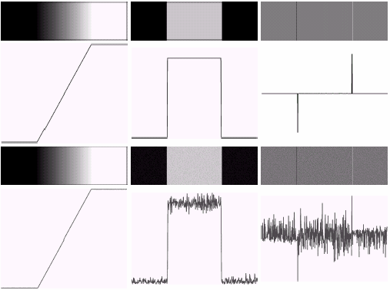
Detection of Discontinuities
Edge Detection

Slide 21
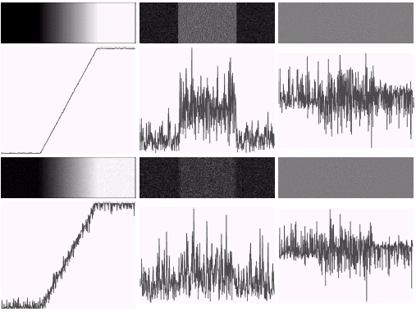
Detection of Discontinuities
Edge Detection

Slide 22
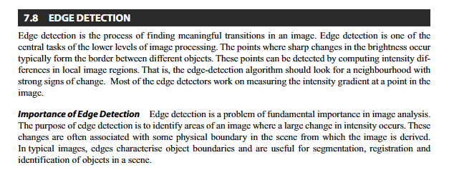

Slide 23
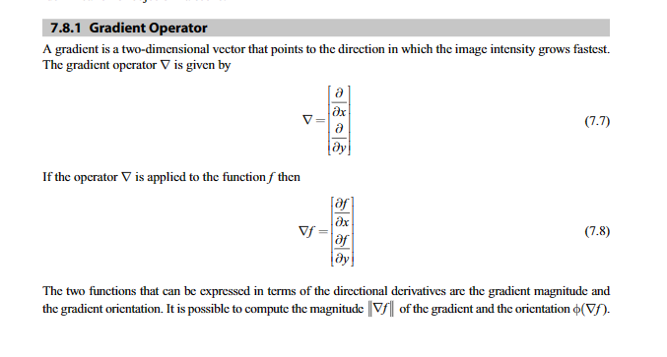

Slide 24
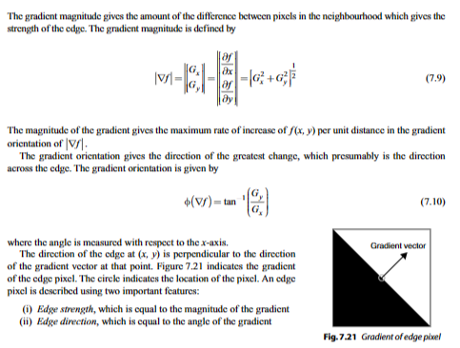

Slide 25
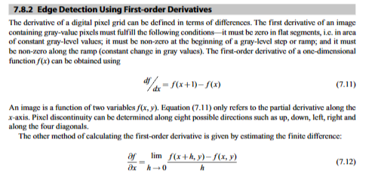

Slide 26
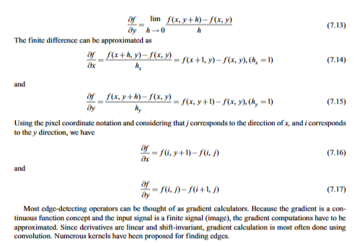

Slide 27
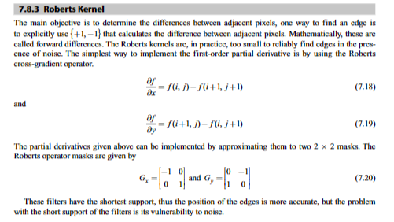

Slide 28
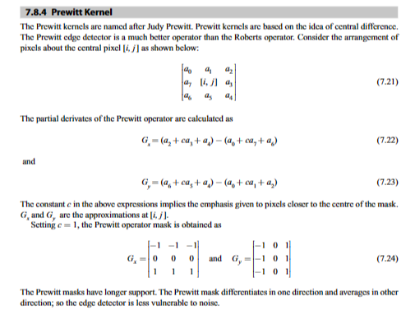

Slide 29
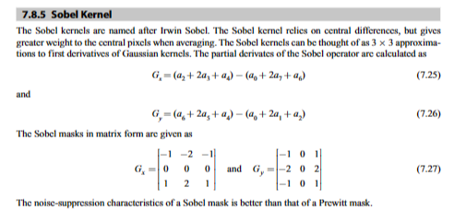

Slide 30
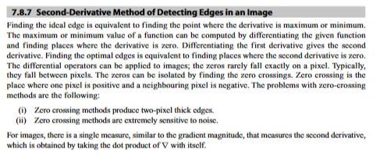

Slide 31
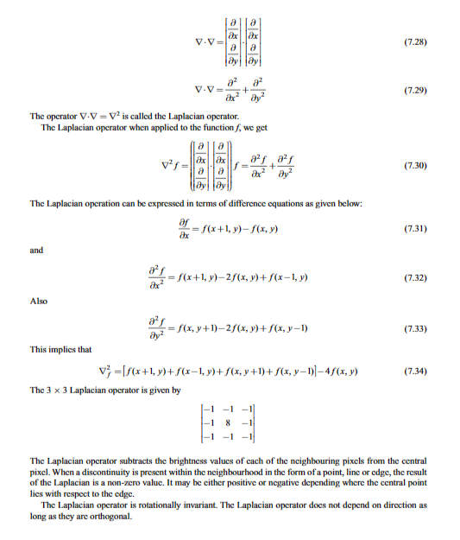

Slide 32
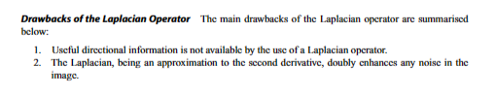

Slide 33
Detection of Discontinuities
Gradient Operators
First-order derivatives:
The gradient of an image f(x,y) at location (x,y) is defined as the vector:
The magnitude of this vector:
The direction of this vector:

Slide 34
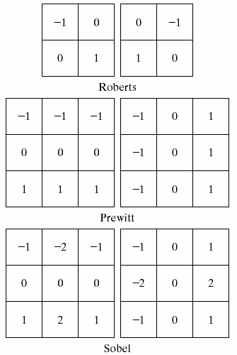
Detection of Discontinuities
Gradient Operators
Roberts cross-gradient operators
Prewitt operators
Sobel operators

Slide 35
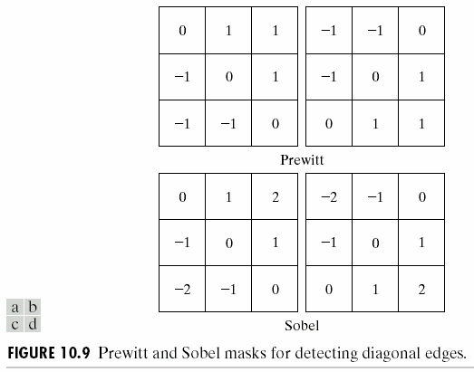
Detection of Discontinuities
Gradient Operators
Prewitt masks for
detecting diagonal edges
Sobel masks for
detecting diagonal edges

Slide 36
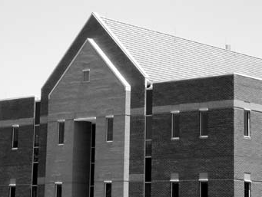
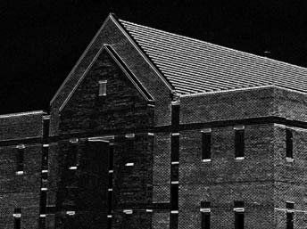
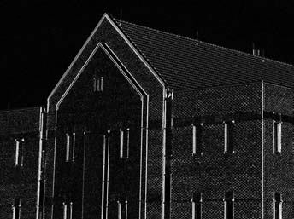
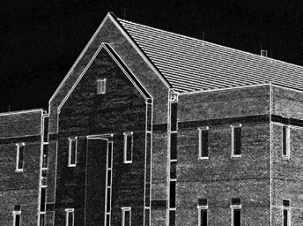
Detection of Discontinuities
Using Sobel Gradient Operators: Example
Original image -834x114
Sobel Gradient –X-direction |Gx|
|Sobel Gradient –Y-direction |Gy|
|Gx| + |Gy|

Slide 38

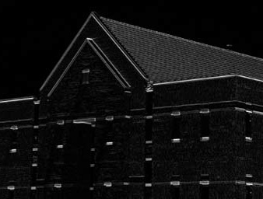
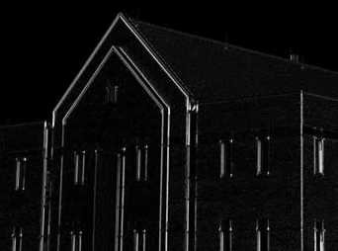
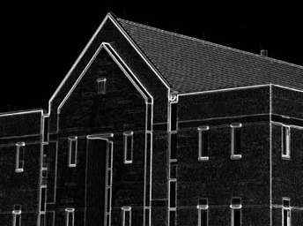
Detection of Discontinuities
Using Sobel Gradient Operators: Example
Original image smoothened by 5x5 averaging mask

Slide 39
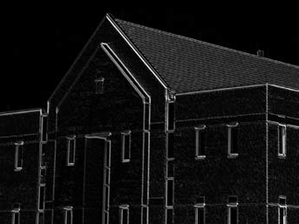
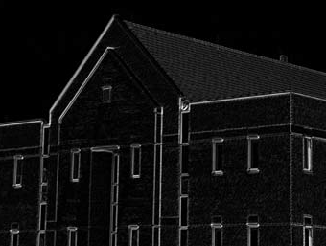
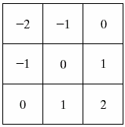
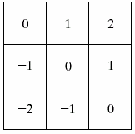
Detection of Discontinuities
Diagonal Gradient Operators: Example

Slide 40
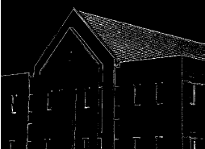
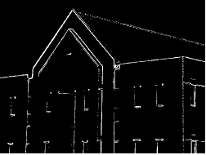
Detection of Discontinuities
Combining the gradient with thresholding (33%)

Slide 41
IPT’s function edge provides several derivative estimators. For some of these estimators, it is possible to stecify whether thye edge detector is sensitive to horizontal or vertical edges or to both. The general sytax for this function is
[g, t]= edge (f, ‘method’ , parameters)
Where f is the input image, method is one of the approaches listed in Table and parameters are additional parameters explained later.

Slide 42
The general calling syntax for the Sobel detector is
[g, t] = edge (f, ‘sobel’ , T , dir)
where T is a specified threshold, and dir specifies the preferred direction of the edges detected: ‘horizontal’, ‘vertical’ , or ‘both’ ( the default).
As noted earlier, g is a logical image containing 1s at locations where edges were detecfted and 0s elsewhere.

Slide 43
The Prewitt edge detector uses the masks in Fig.10.14 to approximate digitally the first derivatives Gx and Gy. It’s general calling synax is
[g,t]=edge(f,’prewitt’, T, dir)
the parameters of this function are identical to the Sobel parameters.

Slide 44
Canny Edge Detection
The algorithm is more complex,
The performance of the Canny edge detector (Canny [1986]) is superior in general to the edge detectors discussed earlier.
Canny’s approach is based on three basic objectives:
Low error rate. All edges should be found, and there should be no spurious responses. That is, the edges detected must be as close as possible to the true edges.
Edge points should be well localized. The edges located must be as close as possible to the true edges. That is, the distance between a point marked as an edge by the detector and the center of the true edge should be minimum.
Single edge point response. The detector should return only one point for each true edge point. That is, the number of local maxima around the true edge should be minimum. This means that the detector should not identify multiple edge pixels where only a single edge point exists.
The essence of Canny’s work was in expressing the preceding three criteria mathematically and then attempting to find optimal solutions to these formulations.
In general, it is difficult (or impossible) to find a closed-form solution

Slide 45
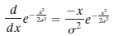
STEP1 :Smooth the input image with a Gaussian filter.
Using numerical optimization with 1-D step edges corrupted by additive white Gaussian noise
White noise is noise having a frequency spectrum that is Continuous and uniform over a specified frequency band.
White Gaussian noise is noise in which the distribution of amplitude values is Gaussian.
Gaussian white noise is a good approximation of many real-world situations and generates mathematically tractable models.
It has the useful property that its values are statistically independent
A good approximation† to the optimal step edge detector is the first derivative of Gaussian

Slide 46
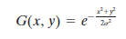
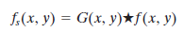
STEP1 :Smooth the input image with a Gaussian filter
Let f(x,y) is image and G(x,y) is Gaussian function
We Form fs(x,y) by convolving G and f

Slide 47
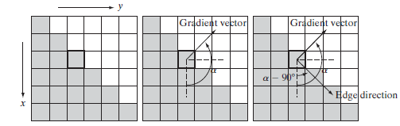
Gradient operation
Using the gradient to determine edge strength and direction at a point. Note that the edge is perpendicular to the direction of the gradient vector at the point where the gradient is computed. Each square in the figure represents one pixel.

Slide 48
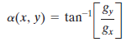
STEP 2:Compute the gradient magnitude and angle images.
Generalizing this result to 2-D involves recognizing that the 1-D approach still applies in the direction of the edge normal Because the direction of the normal is unknown beforehand, this would require applying the 1-D edge detector in all possible directions.
This task can be approximated by first smoothing the image with a circular 2-D Gaussian function, computing the gradient of the result, and then using the gradient magnitude and direction to estimate edge strength and direction at every point.
computing the gradient magnitude and direction(angle)

Slide 49
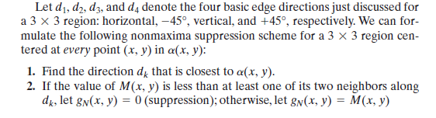
STEP 3: Apply nonmaxima suppression to the gradient magnitude image.
The essence of the approach is to specify a number of discrete orientations of the edge normal (gradient vector).
For example, in a region we can define four orientations† for an edge passing through the center point of the region: horizontal, vertical, +45 degree and -45 degree
Figure shows, if the edge normal is in the range of directions from -22.5 degree and +22.5 degree or from -157.5 degree to +157.5 degree we call the edge a horizontal edge

Slide 50
Canny Edge Detection

Slide 51
STEP-4: Use double thresholding and connectivity analysis to detect and link edges
If we set the threshold too low, there will still be some false edges (called false positives).
If the threshold is set too high, then actual valid edge points will be eliminated (false negatives).
Canny’s algorithm attempts to improve on this situation by using hysteresis thresholding
It uses two thresholds: a low threshold ,and a high threshold
Canny suggested that the ratio of the high to low threshold should be two or three to one.
We can visualize the thresholding operation as creating two additional images

Slide 52
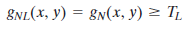
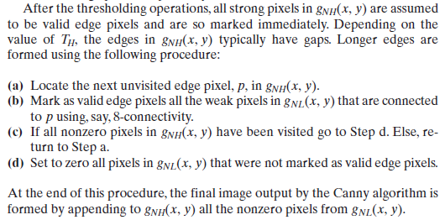
STEP-4: Use double thresholding and connectivity analysis to detect and link edges

Slide 53
(a) Original image of size pixels, with intensity values scaled to the range [0, 1].
(b) Thresholded gradient of smoothed image.
(c) Imageobtained using the Marr-Hildreth algorithm.
(d) Image obtained using the Canny algorithm.

Slide 54
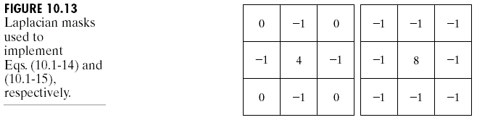
Detection of Discontinuities
Gradient Operators
Second-order derivatives: (The Laplacian)
The Laplacian of an 2D function f(x,y) is defined as
Two forms in practice:

Slide 55
Detection of Discontinuities
Gradient Operators
Consider the function:
The Laplacian of h is
The Laplacian of a Gaussian sometimes is called the Mexican hat function. It also can be computed by smoothing the image with the Gaussian smoothing mask, followed by application of the Laplacian mask.
A Gaussian function
The Laplacian of a Gaussian (LoG)

Slide 56
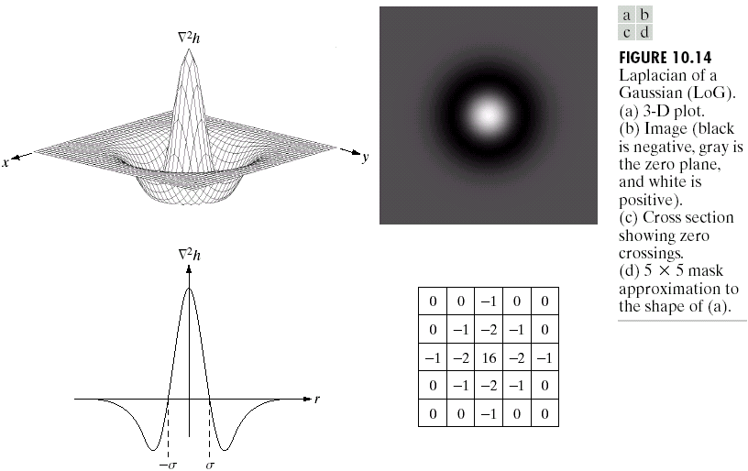
Detection of Discontinuities
Gradient Operators

Slide 57
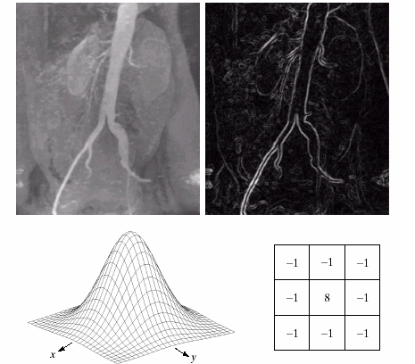
Detection of Discontinuities
Gradient Operators: Example
Sobel gradient
Gaussian smooth function
Laplacian mask

Slide 58


Detection of Discontinuities
Gradient Operators: Example

Slide 59
Edge Linking and Boundary Detection
Local Processing
Two properties of edge points are useful for edge linking:
the strength (or magnitude) of the detected edge points
their directions (determined from gradient directions)
This is usually done in local neighborhoods.
Adjacent edge points with similar magnitude and direction are linked.
For example, an edge pixel with coordinates (x₀,y₀) in a predefined neighborhood of (x,y) is similar to the pixel at (x,y) if

Slide 60

Edge Linking and Boundary Detection
Local Processing: Example
In this example,
we can find the
license plate
candidate after
edge linking
process.

Slide 61


Thresholding
Assumption: the range of intensity levels covered by objects of interest is different from the background.
Single threshold
Multiple threshold

Slide 62

The role of noise in image thresholding
Noiseless 8-bit image.
Image with additive Gaussian noise of mean 0 and standard deviation of 10 intensity levels.
Image with additive Gaussian noise of mean 0 and standard deviation of 50 intensity levels.
(d)–(f) Corresponding histograms.

Slide 63



Thresholding
The Role of Illumination

Slide 64



Thresholding
The Role of Illumination
(a)
(c)
(d)
(e)

Slide 65

Thresholding
Basic Global Thresholding

Slide 66


Slide 67


Slide 68


Slide 69
Region-Based Segmentation
Edges and thresholds sometimes do not give good results for segmentation.
Region-based segmentation is based on the connectivity of similar pixels in a region.
Each region must be uniform.
Connectivity of the pixels within the region is very important.
There are two main approaches to region-based segmentation: region growing and region splitting.

Slide 70

Region-Based Segmentation
Region Growing

Slide 71
Region-Based Segmentation
Basic Formulation
Let R represent the entire image region.
Segmentation is a process that partitions R into subregions, R₁,R₂,…,R_{n}, such that
where P(R_{k}): a logical predicate defined over the points in set R_{k}
For example: P(R_{k})=TRUE if all pixels in R_{k} have the same gray level.

Slide 72

Region-Based Segmentation
Region Growing

Slide 73


Region-Based Segmentation
Region Growing
Fig. 10.41 shows the histogram of Fig. 10.40 (a). It is difficult to segment the defects by thresholding methods. (Applying region growing methods are better in this case.)
Figure 10.40(a)
Figure 10.41

Slide 74


Slide 75


Slide 76
Region-Based Segmentation
Region Splitting and Merging
Region splitting is the opposite of region growing.
First there is a large region (possible the entire image).
Then a predicate (measurement) is used to determine if the region is uniform.
If not, then the method requires that the region be split into two regions.
Then each of these two regions is independently tested by the predicate (measurement).
This procedure continues until all resulting regions are uniform.

Slide 77

Region-Based Segmentation
Region Splitting and Merging
The main problem with region splitting is determining where to split a region.
One method to divide a region is to use a quadtree structure.
Quadtree: a tree in which nodes have exactly four descendants.

Slide 78

Region-Based Segmentation
Region Splitting and Merging
The split and merge procedure:
Split into four disjoint quadrants any region R_{i} for which P(R_{i}) = FALSE.
Merge any adjacent regions R_{j} and R_{k} for which P(R_{j}UR_{k}) = TRUE. (the quadtree structure may not be preserved)
Stop when no further merging or splitting is possible.

Slide 79


Slide 80


Slide 81


Slide 82


Slide 83


Slide 84


Slide 85


Slide 86
END

